Slide 1

Contract Monthly Claim System
PROG6212 POE Part 3 – 2025
Luis Jose De Sousa Junior- ST10307204
IIE Varsity College Cape Town

Slide 2

WebApp Overview
A Complete Claims Ecosystem • Secure • Role-Based Dashboards with Live Statistics• Modern •
File Storage & Session Management

Slide 3
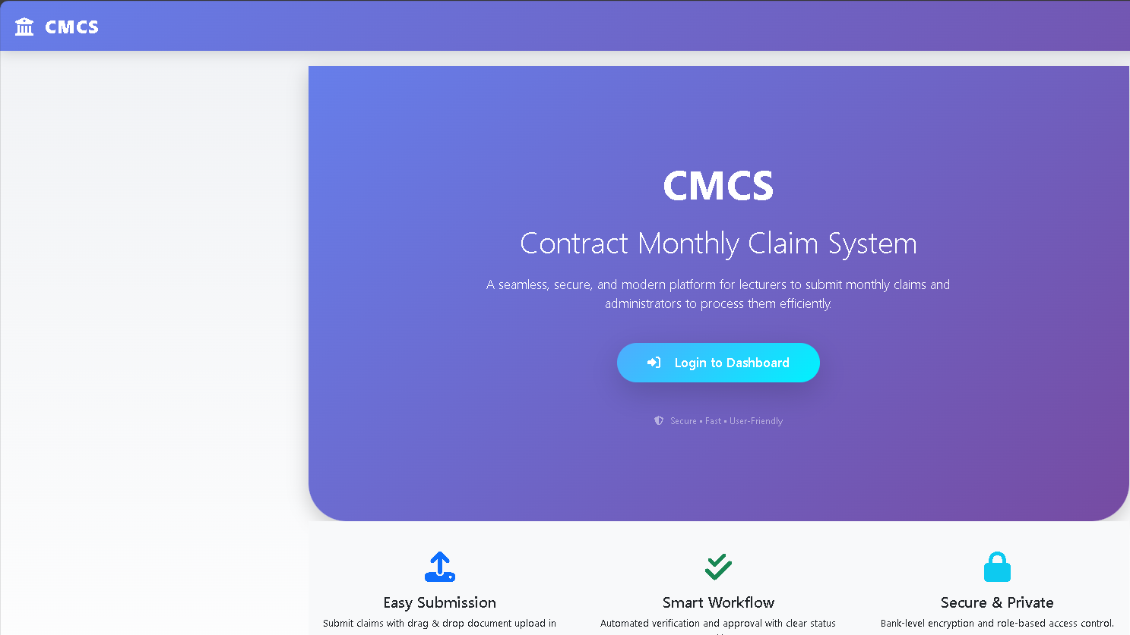
Home Page

Slide 4
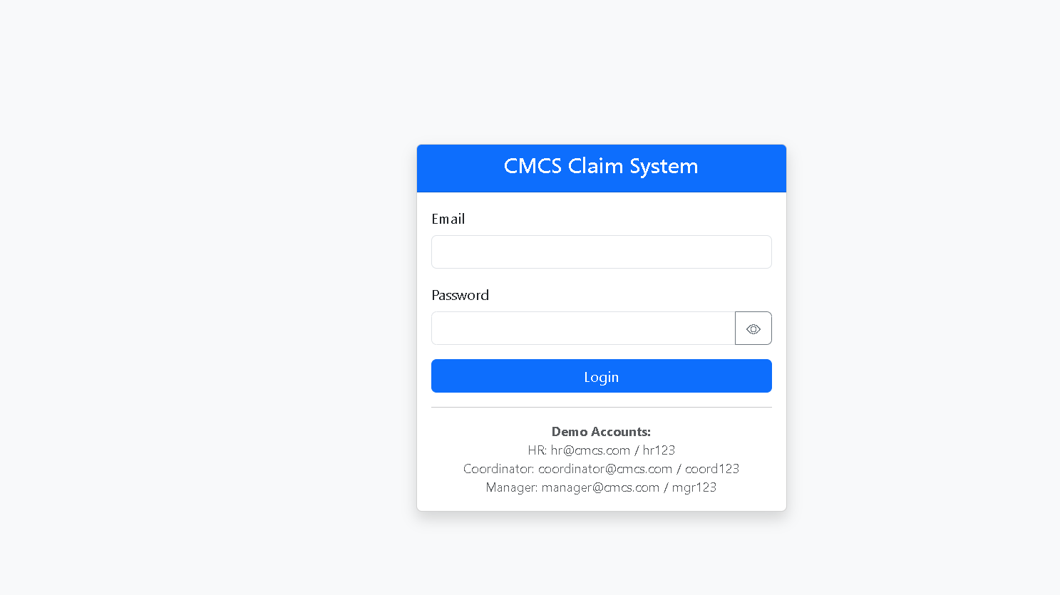
Login Page

Slide 5
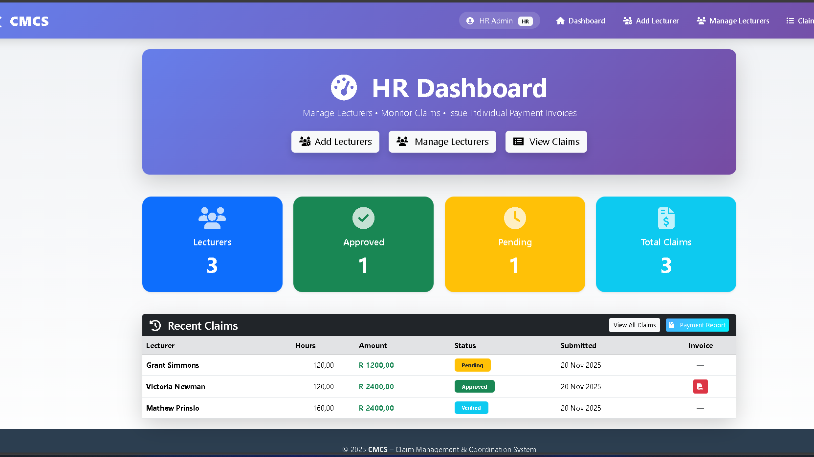
HR

Slide 6
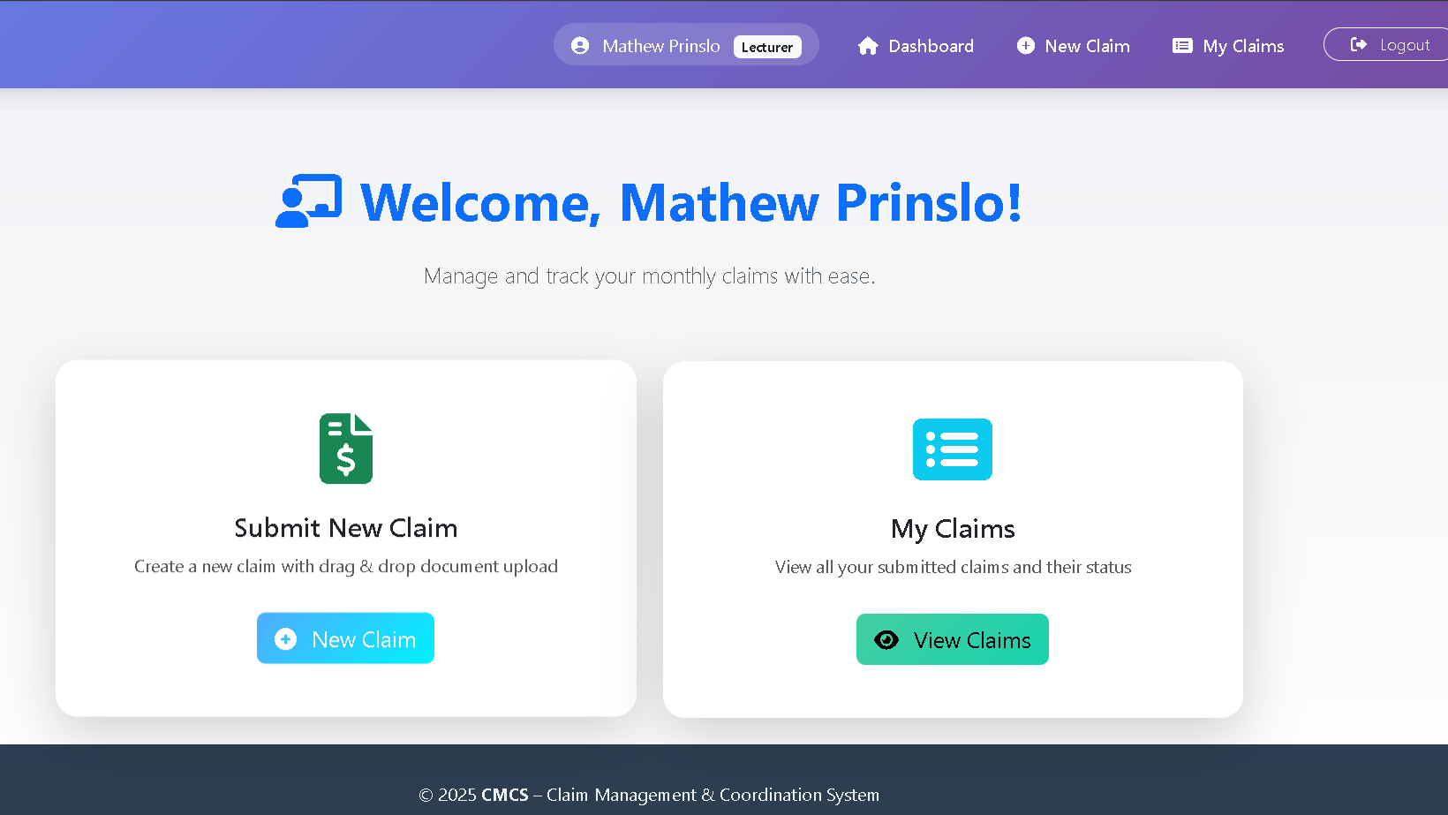
Lecturer

Slide 7
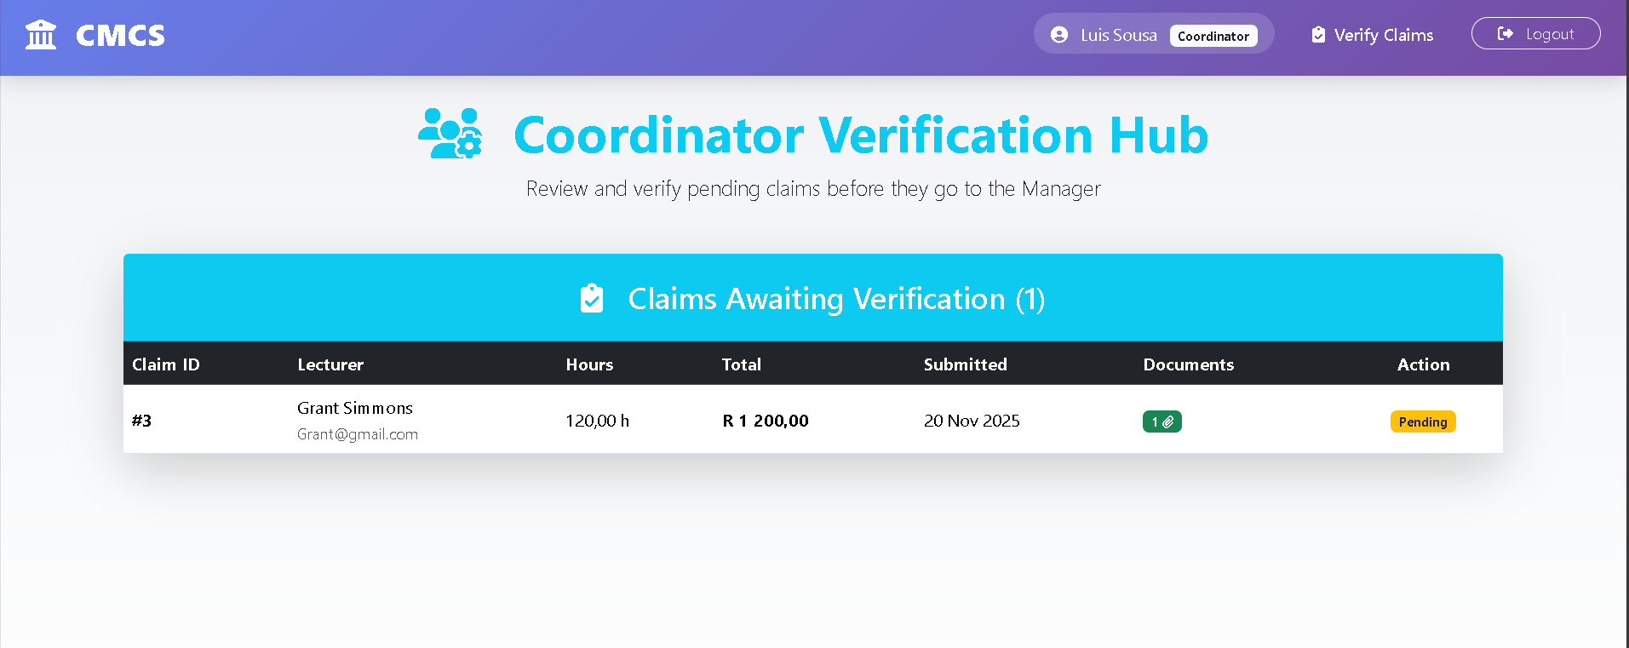
Coordinator

Slide 8
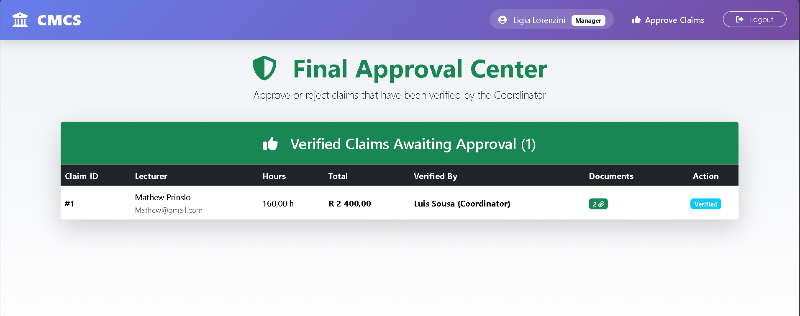
Manager

Slide 9
Lecturer Feed back from Part 2
optimise the UX for uploading documents into the claim creation instead of having the user make an update database call later when adding a supporting document
1
Make a drag and drop zone for documents
2
Generate a modal window pop-up (blurring the background) showing the details of the claim with the action buttons inside.
3

Slide 10
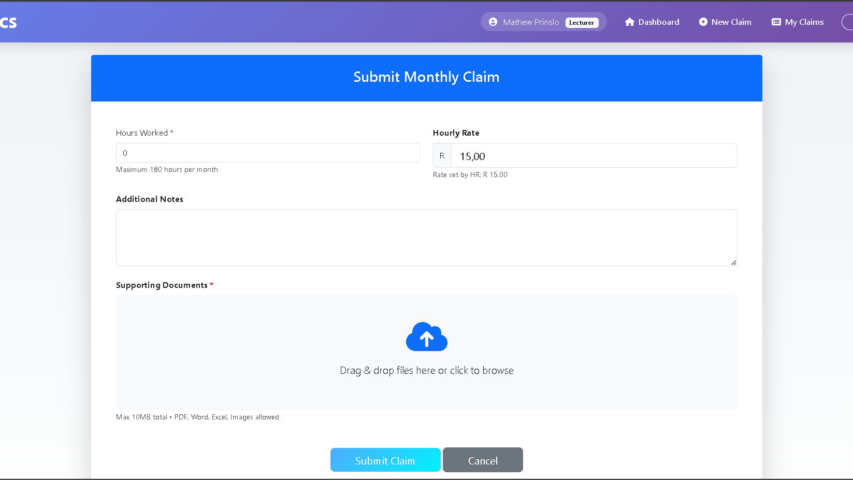
Feedback 1&2

Slide 11
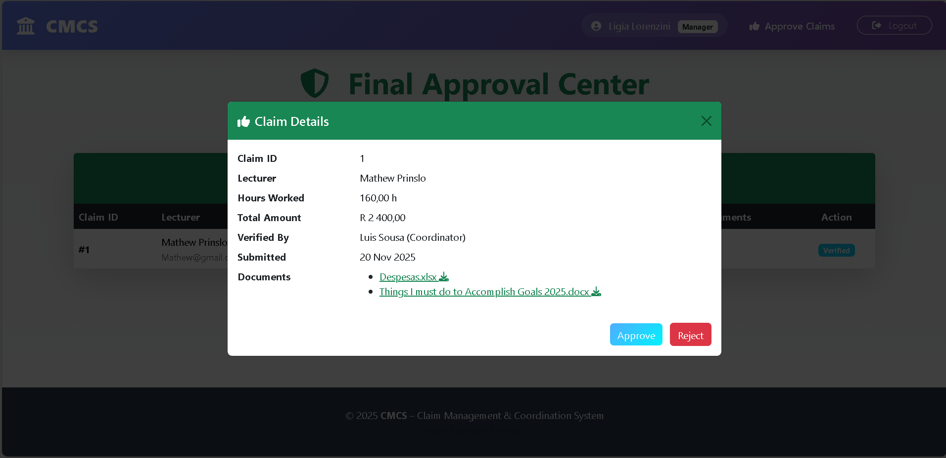
Feedback 3

Slide 12

Other Key aspects and Features
Visual Progress Bar on Track Claim (Pending → Verified → Approved) Individual
Professional PDF Invoice per Approved Claim (QuestPDF)
Real-Time Payment Report for HR (Web View + Download)
Clickable Document Downloads Inside Coordinator and Manager Modals

Slide 13
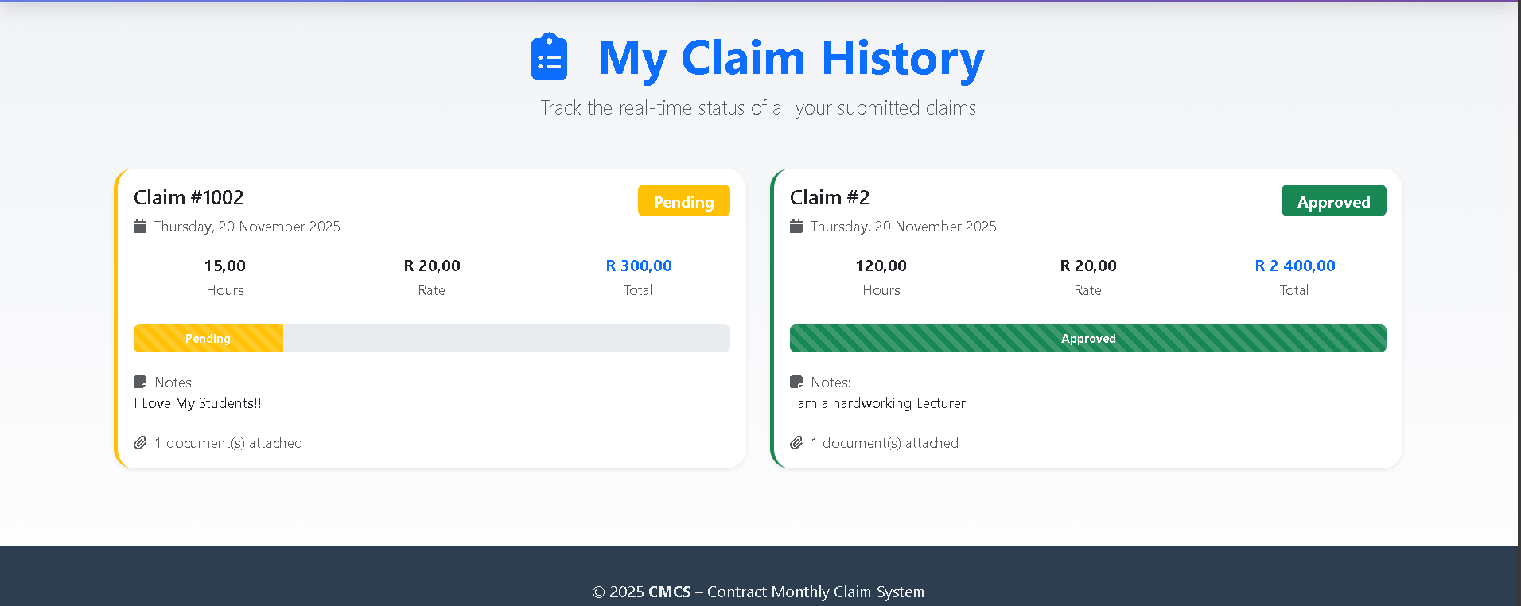
Track Claims Progress Bar

Slide 14
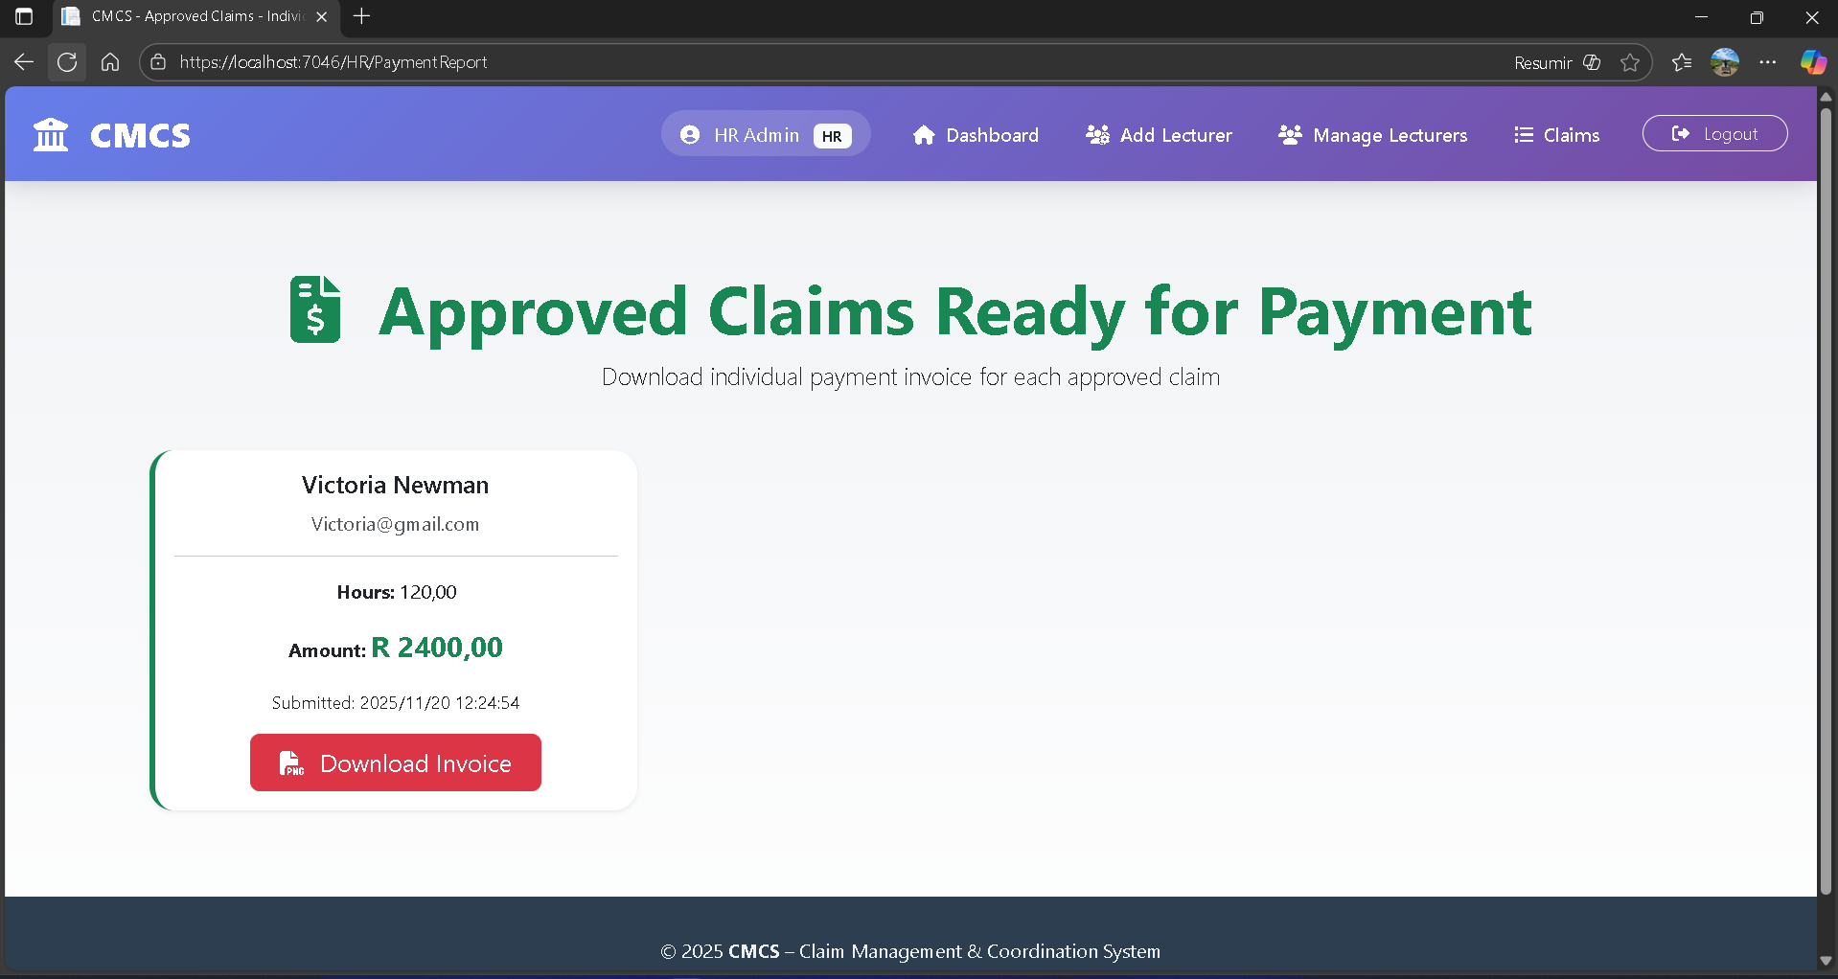
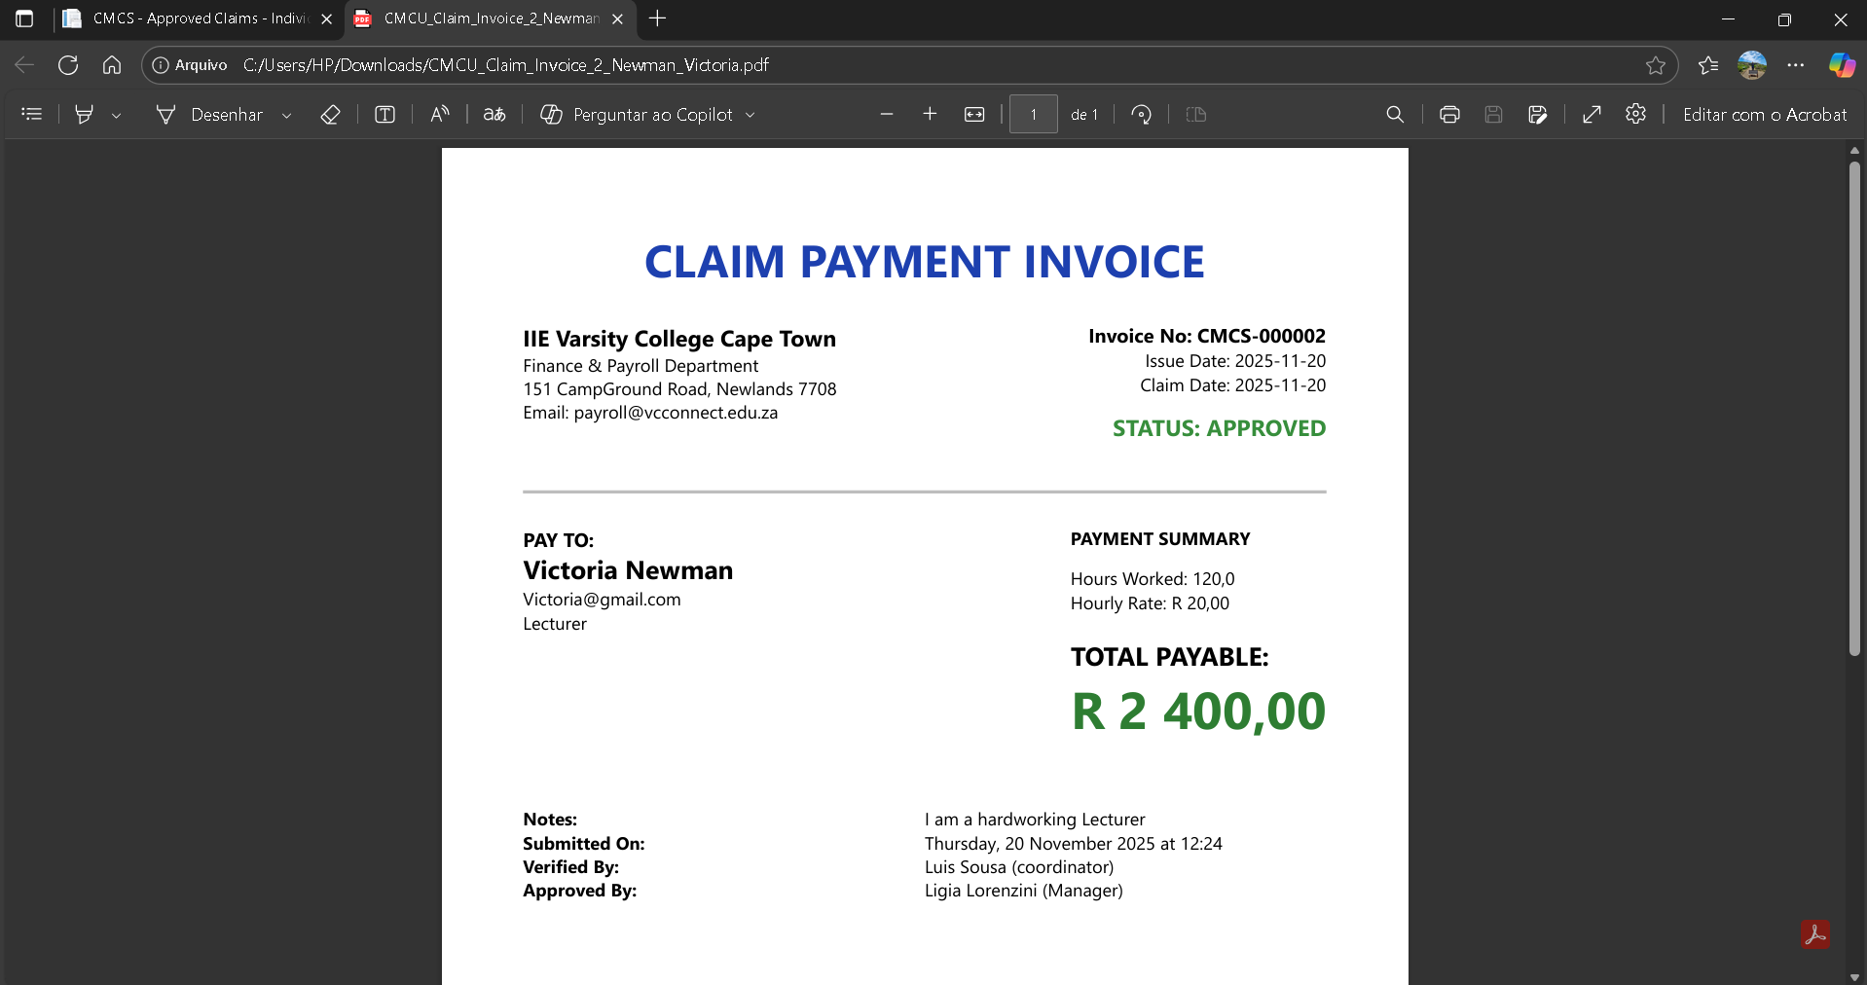
HR Payment Report and Invoice

Slide 15
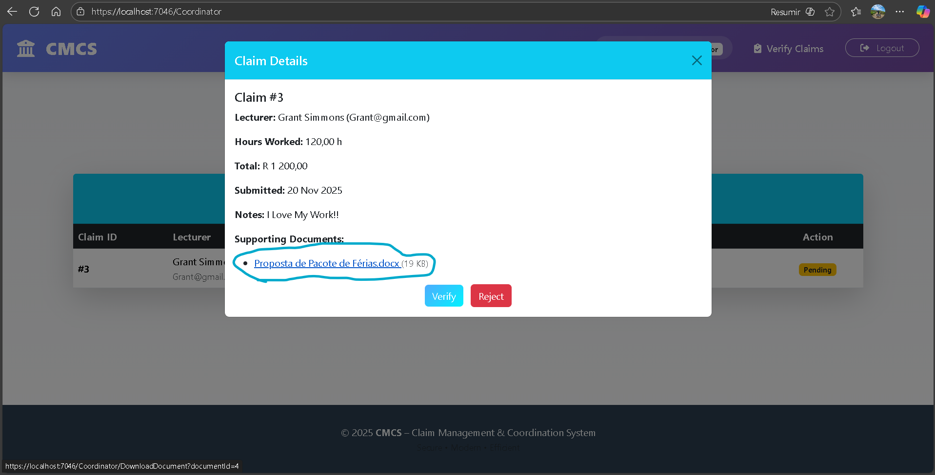
Coordinator & Manager Download link in Modals

Slide 16

ALL DONE! THANK YOU
Now Lets Do Some Live Demonstration

